Slide 1
PROSPER Property Resale Price Forecaster
BY TEAM DIGITAL CATALYST

Slide 2
Why is housing important in Sg?
Notes:
Housing is cosidered a huge iinvestment by every Sgpoream. SO lets sat you are a Sgporean. I am sure you will be extremely thrilled to know what will be the future price of my flat.

Slide 3
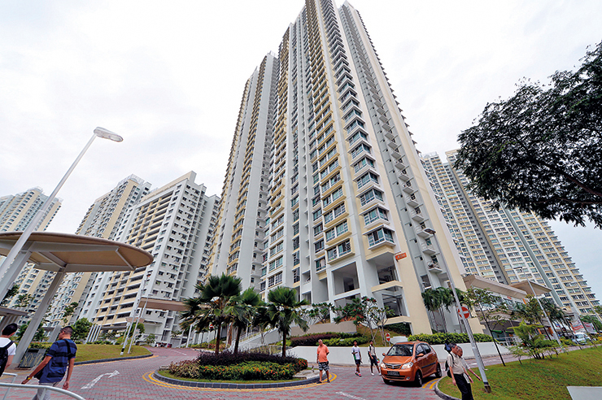
How would you like to predict the future?

Slide 4
15 years
480,000 data points
PROSPER helps you to predict your property value depending on various parameters by learning with the data from the past
with over

Slide 5
How accurate?

Slide 6
DEMO

Slide 7
Learning Model
Gradient Boosted Decision Tree.
Other models are tried, including decision forest, NN regression, deep NN.
Hyper-parameter tuned using parameter sweeping using random sweep with 10 folds.
Trained over 480,000 data points.
Price accuracy of 95% in average.

Slide 8
Pro Analytics
Multiple requests to the web service to obtain the point of time where it is most profitable to sell the flat with certain annual value growth.

Slide 9
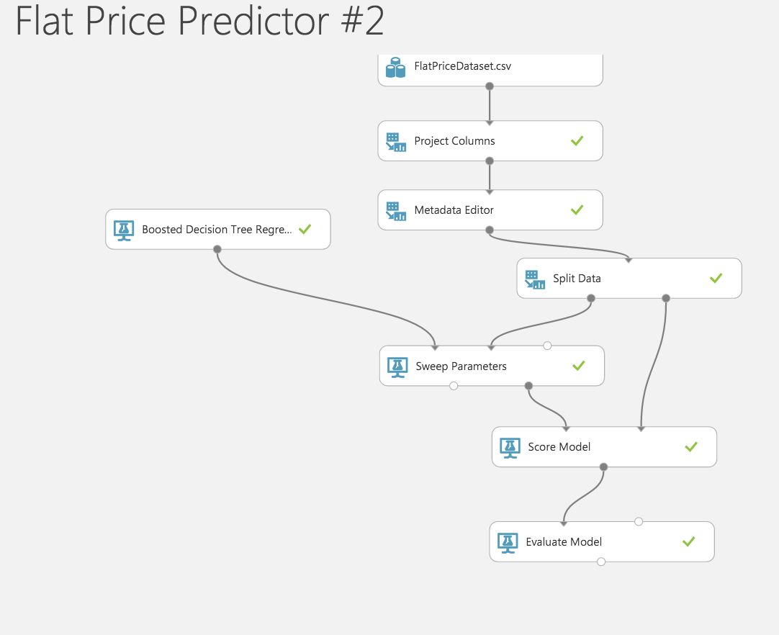

Slide 10
Thank you!

